Slide 1
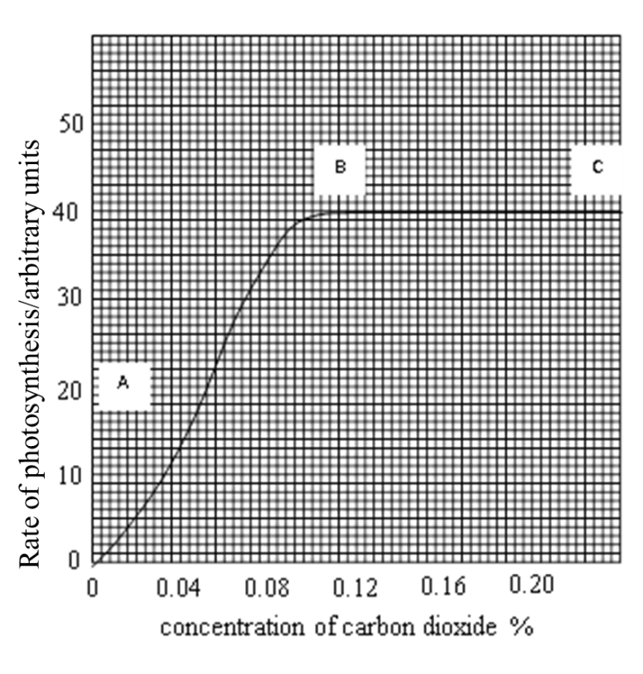
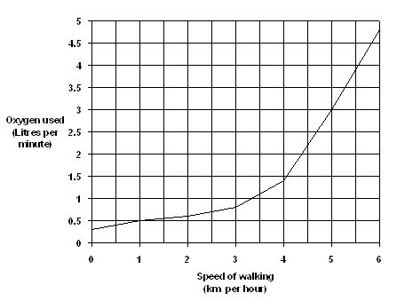
Describe the effect of CO₂ conc. on the rate of photosynthesis. (2)
Explain the effect of CO₂ conc. on the rate of photosynthesis. (3)
Describe the effect of increasing walking speed on oxygen use. (3)
Explain the effect of increasing walking speed on oxygen use. (2)

Slide 2
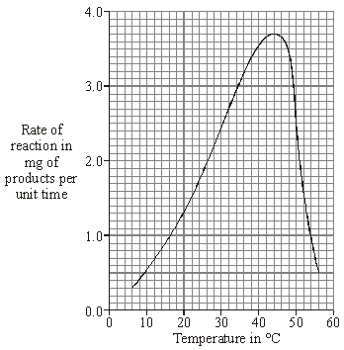
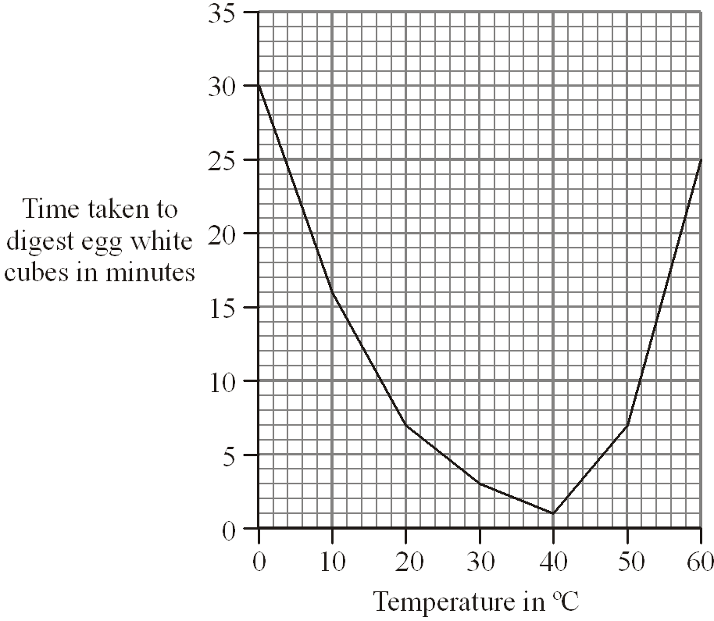
Describe the effect of temperature on the rate of reaction. (3)
Explain the effect of temperature on the rate of reaction. (4)
Describe the effect of temperature on the time taken to digest the egg white. (3)
Explain the effect of temperature on the time taken to digest the egg white. (4)

